Slide 1
The .NET Technology
Unit-1
Reference:
https://docs.microsoft.com
https://dotnettutorials.net
https://dotnet.microsoft.com

Slide 2
Introduction to .NET
.NET is a free, open-source development platform for building many kinds of apps, such as:
  Web apps, web APIs, and microservices
  Serverless functions in the cloud
  Cloud native apps
  Mobile apps
  Desktop apps
  Windows WPF
  Windows Forms
  Universal Windows Platform (UWP)
  Games
  Internet of Things (IoT)
  Machine learning
  Console apps
  Windows services

Slide 3
Background
Before .NET Framework COM was in use.
COM stands for Component Object Model.
The COM was one of Microsoft Technologies.
Using this technology one could develop windows applications as well as web applications.
In earlier COM, VB was the programming language that was used to implement windows application and ASP was used to implement web applications.

Slide 4
Background
The major two disadvantages of COM were
Incomplete object-oriented programming; means it would not support all the features of OOPs.
Platform dependent; means COM applications can run on only Windows OS.
To overcome the above problems, the .NET Framework came into the market.
The name “.NET” has two components: dot “.” refers to object-oriented and NET stands for Network Enabled Technology.

Slide 5
Background
.NET is a software framework which is designed and developed by Microsoft.
The first version of the .NET framework was 1.0 which came in the year 2002.
.NET Framework supports more than 60 programming languages in which 11 programming languages are designed and developed by Microsoft.
The remaining Non-Microsoft Languages which are supported by .NET Framework but not designed and developed by Microsoft.

Slide 6
Features of .NET
Cross Platform
  you can create .NET apps for many operating systems, including: Windows, macOS, Linux, Android, iOS, tvOS, watchOS
Open Source
  .NET is open source, using MIT and Apache 2 licenses.
  .NET is a project of the .NET Foundation

Slide 7
Features of .NET
Support
  .NET is supported by Microsoft on Windows, macOS, and Linux.
  It's updated regularly for security and quality, on the second Tuesday of each month.
Tools and Productivity
  .NET gives you a choice of languages, integrated development environments (IDEs), and other tools.

Slide 8
Features of .NET
Programming Languages: .NET mainly supports three programming languages:
C#
  C# (pronounced "See Sharp") is a modern, object-oriented, and type-safe programming language.
  C# has its roots in the C family of languages and will be immediately familiar to C, C++, Java, and JavaScript programmers.
F#
  The F# language supports functional, object-oriented, and imperative programming models.

Slide 9
Features of .NET
Visual Basic
  Among the .NET languages, the syntax of Visual Basic is the closest to ordinary human language, which can make it easier to learn.
  Unlike C# and F#, for which Microsoft is actively developing new features, the Visual Basic language is stable.
  Visual Basic isn't supported for web apps, but it is supported for web APIs.

Slide 10
Features of .NET
IDEs: The integrated development environments for .NET include:
Visual Studio
  Runs on Windows only.
  Has extensive built-in functionality designed to work with .NET.
  The Community edition is free for students, open-source contributors, and individuals.
Visual Studio Code
  Runs on Windows, macOS, and Linux.
  Free and open source.
  Extensions are available for working with .NET languages.
Visual Studio for Mac
  Runs on macOS only.
  For developing .NET apps and games for iOS, Android, and web.
GitHub Codespaces
  An online Visual Studio Code environment, currently in beta.

Slide 11
Features of .NET
SDK and runtime: The .NET SDK is a set of libraries and tools for developing and running .NET applications.
When you download .NET, you can choose the SDK or a runtime, such as the .NET runtime or the ASP.NET Core runtime.
Install a runtime on a machine that you want to prepare for running .NET apps.
Install the SDK on a machine that you want to use for development.
When you download the SDK, you automatically get the runtimes with it.

Slide 12
Features of .NET
Project system and MSBuild
  A .NET app is built from source code by using MSBuild.
  A project file (.csproj, .fsproj, or .vbproj) specifies targets and associated tasks that are responsible for compiling, packing, and publishing code.

Slide 13
Implementations of .NET
There are various implementations of .NET
Each implementation allows .NET code to execute in different places—Linux, macOS, Windows, iOS, Android, and many more.
.NET Framework is the original implementation of .NET.
  It supports running websites, services, desktop apps, and more on Windows.
.NET Core is a cross-platform implementation for running websites, services, and console apps on Windows, Linux, and macOS.
  .NET Core is open source on GitHub.
Xamarin/Mono is a .NET implementation for running apps on all the major mobile operating systems, including iOS and Android.

Slide 14
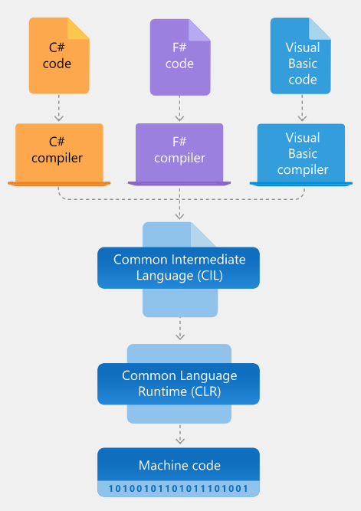
Architecture of .NET Framework

Slide 15
Architecture of .NET Framework
The two major components of .NET Framework are:
  Common Language Runtime
  .NET Framework Class Library
Common Language Runtime (CLR) is the execution engine that handles running applications.
  It provides services like thread management, garbage collection, type-safety, exception handling, and more.

Slide 16
Architecture of .NET Framework
Class Library provides a set of APIs and types for common functionality.
  It provides types for strings, dates, numbers, etc.
  The Class Library includes APIs for reading and writing files, connecting to databases, drawing, and more.

Slide 17
Architecture of .NET Framework
.NET applications are written in the C#, F#, or Visual Basic programming language.
Code is compiled into a language-agnostic Common Intermediate Language (CIL).
Compiled code is stored in assemblies—files with a .dll or .exe file extension.
When an app runs, the CLR takes the assembly and uses a just-in-time compiler (JIT) to turn it into machine code that can execute on the specific architecture of the computer it is running on.

Slide 18
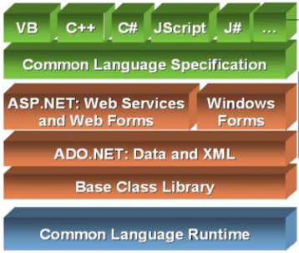
Architecture of .NET Framework

Slide 19
Architecture of .NET Framework
CLR
  .Net Framework provides runtime environment called Common Language Runtime (CLR).
  It provides an environment to run all the .Net Programs.
  The code which runs under the CLR is called as Managed Code.
  Programmers need not to worry on managing the memory if the programs are running under the CLR as it provides memory management and thread management.

Slide 20
Architecture of .NET Framework
Managed Code
  The code, which is developed in .NET framework, is known as managed code.
  This code is directly executed by CLR with help of managed code execution.
  Any language that is written in .NET Framework is managed code.
  Managed code uses CLR which in turns looks after your applications by managing memory, handling security, allowing cross - language debugging, and so on.

Slide 21
Architecture of .NET Framework
Unmanaged Code
  The code, which is developed outside .NET framework is known as unmanaged code.
  Applications that do not run under the control of the CLR are said to be unmanaged, and certain languages such as C++ can be used to write such applications, which, for example, access low - level functions of the operating system.
  Unmanaged code can be unmanaged source code and unmanaged compile code.
  Unmanaged code is executed with help of wrapper classes.

Slide 22
Architecture of .NET Framework
Base Class Library is common for all types of applications i.e. the way you access the Library Classes and Methods in VB.NET will be the same in C#, and it is common for all other languages in .NET.
The following are different types of applications that can make use of .NET class library.
    Windows Application.
    Console Application
    Web Application.
    XML Web Services.
    Windows Services.
In short, developers just need to import the BCL in their language code and use its predefined methods and properties to implement common and complex functions like reading and writing to file, graphic rendering, database interaction, and XML document manipulation.

Slide 23
Architecture of .NET Framework
Common Type System (CTS)
  It describes set of data types that can be used in different .Net languages in common.
  CTS ensures that objects written in different .Net languages can interact with each other.
  For Communicating between programs written in any .NET complaint language, the types have to be compatible on the basic level.
  The common type system supports two general categories of types: value types and reference types

Slide 24
Architecture of .NET Framework
Common Language Specification (CLS)
  It is a sub set of CTS and it specifies a set of rules that needs to be adhered or satisfied by all language compilers targeting CLR.
  It helps in cross language inheritance and cross language debugging.

Slide 25
Architecture of .NET Framework
JIT (Just-in-Time)
  Just - in - Time (JIT) compiler, which compiles MSIL into native code that is specific to the OS and machine architecture being targeted.
  Only at this point can the OS execute the application.
  The just - in - time part of the name reflects the fact that MSIL (CIL) code is only compiled as, and when, it is needed.

Slide 26
Architecture of .NET Framework
In the past, it was often necessary to compile your code into several applications, each of which targeted a specific operating system and CPU architecture.
This is now unnecessary, because JIT compilers use MSIL (CIL)code, which is independent of the machine, operating system, and CPU.
Several JIT compilers exist, each targeting a different architecture, and the appropriate one will be used to create the native code required.

Slide 27
Architecture of .NET Framework
Assemblies
  When you compile an application, the MSIL code created is stored in an assembly.
  Assemblies include both executable application files that you can run directly from Windows without the need for any other programs (these have a .exe file extension), and libraries (which have a .dll extension) for use by other applications.
  In addition to containing MSIL, assemblies also include meta information (that is, information about the information contained in the assembly, also known as metadata) and optional resources (additional data used by the MSIL, such as sound files and pictures).

Slide 28
Architecture of .NET Framework
Garbage Collection (GC)
  This is the .NET method of making sure that the memory used by an application is freed up completely when the application is no longer in use.
  Prior to .NET this was mostly the responsibility of programmers, and a few simple errors in code could result in large blocks of memory mysteriously disappearing as a result of being allocated to the wrong place in memory.
  That usually meant a progressive slowdown of your computer followed by a system crash.

Slide 29
Architecture of .NET Framework
The Global Assembly Cache (GAC) is a folder in Windows directory to store the .NET assemblies that are specifically designated to be shared by all applications executed on a system.
Assemblies can be shared among multiple applications on the machine by registering them in global Assembly cache(GAC).
GAC is a machine wide a local cache of assemblies maintained by the .NET Framework.

